Slide 1
Git – Exercises
Moritz Flüchter

Slide 2
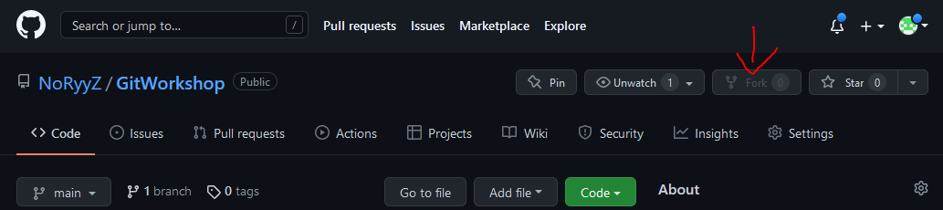
Forking Repositories
„Copies“ the repository to your github
Keeps link to original repository
Do this for: https://github.com/NoRyyZ/GitWorkshopExercises

Slide 3
Excercises
Order
Git History
Merge Conflicts
Branches
Managing Branches

Slide 4
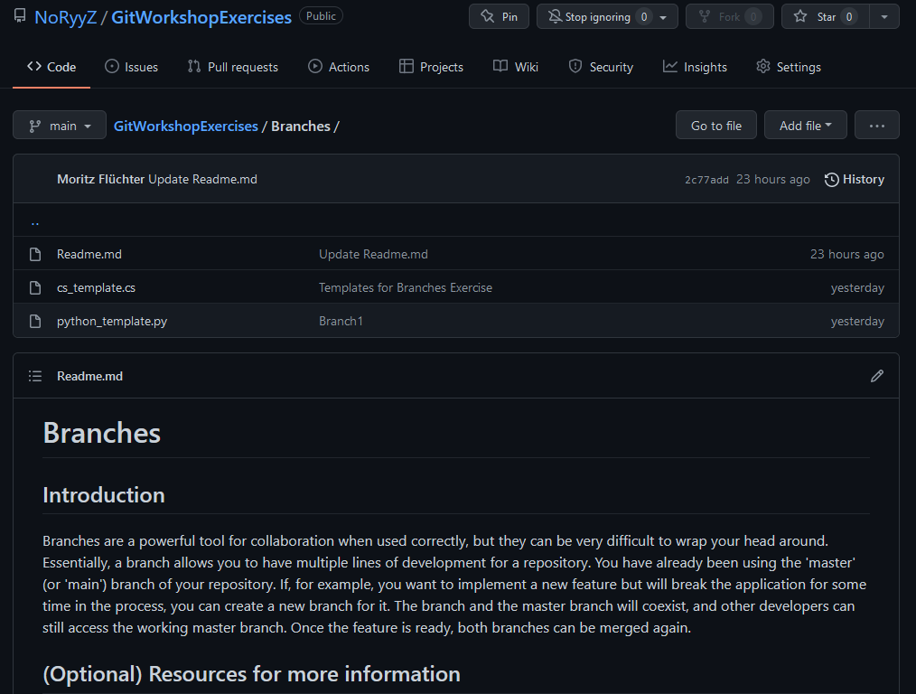
Working on Excercises
Open the exercise folder in your forked repository to view the description
Ask if you have questions!

